Slide 1
Instruction Level Parallelism or Concurrency

Slide 2
Different Paradigm
Pipelining
superscaler
Out of order execution
Dataflow (at ISA level)
SIMD Processing
VLIW
Systolic Array
Decoupled Access Execute

Slide 3
Instructions are fetched and retired in sequential, control flow order. This is part of the Von-Neumann model of computation
(Single program counter, Sequential execution, Control flow determines fetch, execution, commit order)
What about out-of-order execution
Architecture level: Obeys the control-flow model
Uarch level: A window of instructions executed in data-flow order.
execute an instruction when its operands become available
Data Flow uArchitecture

Slide 4
Dataflow Architecture:Exploits Irregular Parallelism
R1
MUL R1,R2,R3
ADD R3,R5,R4
SUB R1,R5, R6
DIVR R4,R6,R7
DIVQ R4,R6,R8
ADD R3,R7,R9
SUB R7,R8,R10
R2
*
R5
R3
-
+
R6
R4
%
/
R7
R8
+
-
R9
R10

Slide 5
Compute Units for Dataflow
In a data flow machine, a program consists of data flow nodes
A data flow node fires (fetched and executed) when all its inputs are ready i.e. when all inputs have tokens
Data flow node and its ISA representation
*
* | R | ARG1 | R | ARG2 | Dest of Result

Slide 6
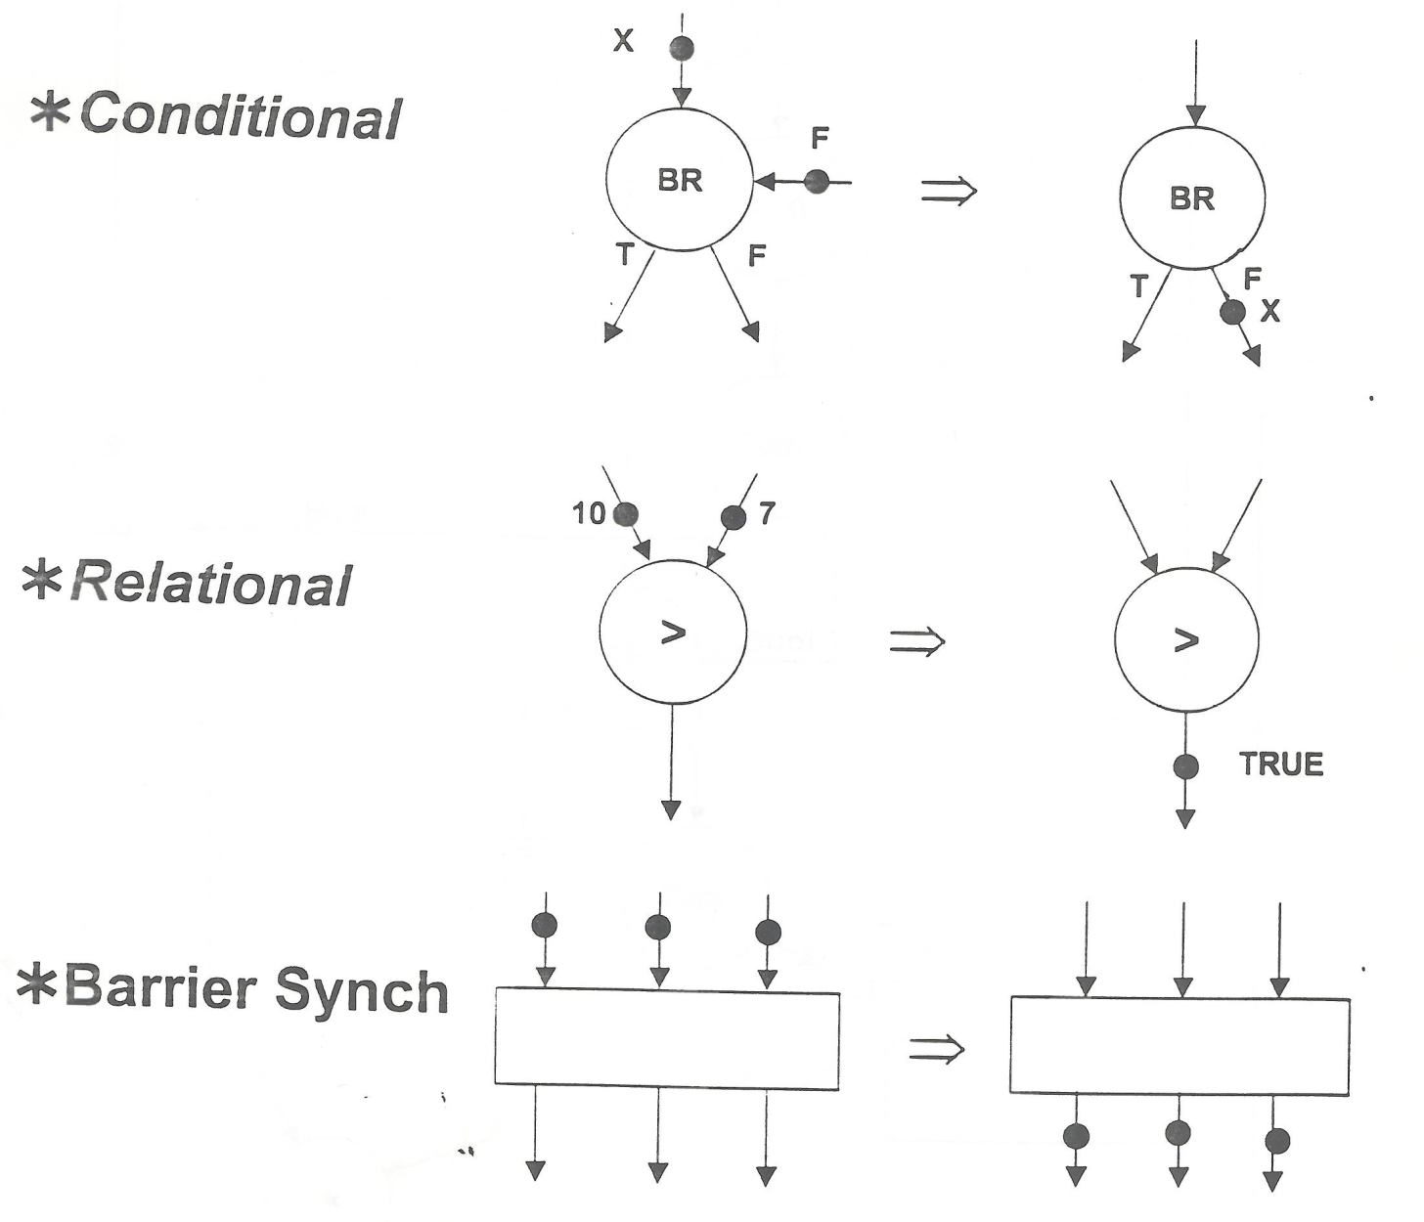
Data Flow Nodes

Slide 7
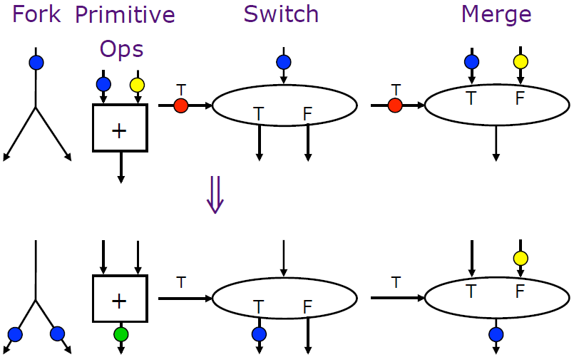
A small set of dataflow operators can be used to define a general programming language

Slide 8
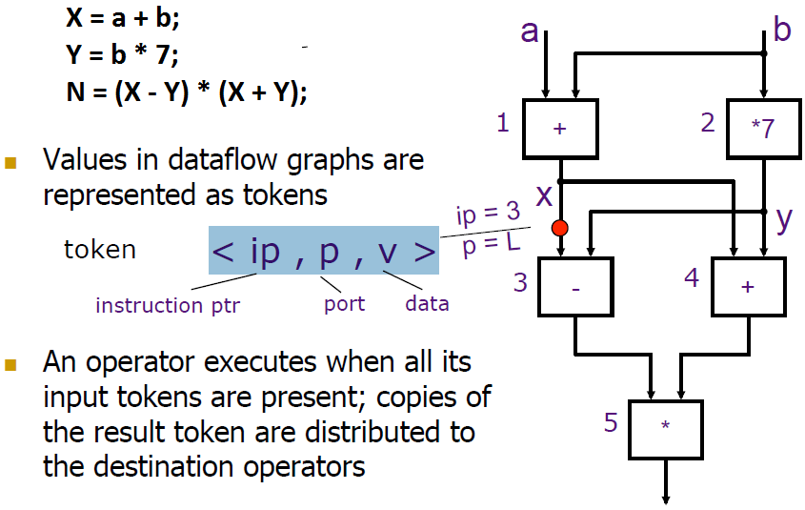

Slide 9
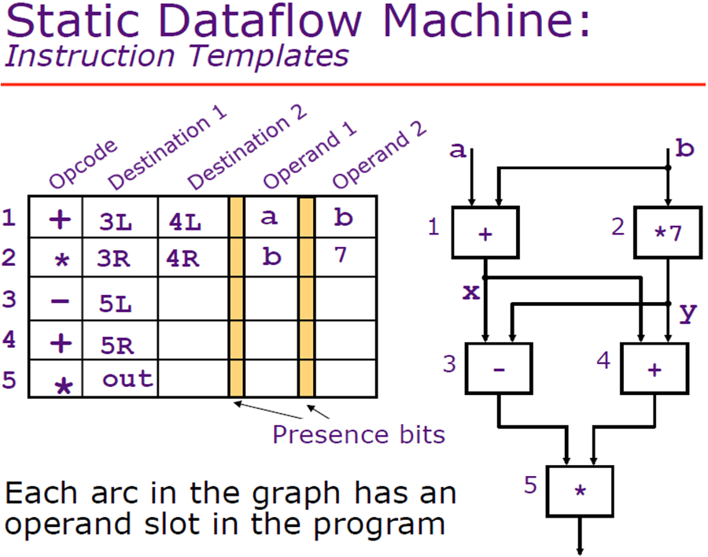

Slide 10


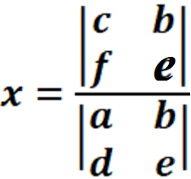
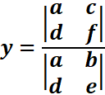
Solution of Linear Equations:
Using Cramer Rule:
x = (ce - bf)/(ae - bd)
y = (af - cd)/(ae - bd)

Slide 11
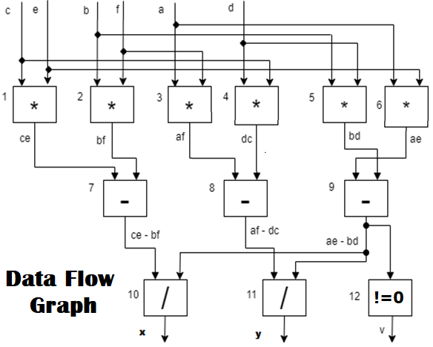

Slide 12
Data Flow Table:
Sr No Node | Op-code | Dest 1 | Dest 2 | Operand 1 | Operand 2
1 | * | 7L |  | c | e
2 | * | 7R |  | b | f
3 | * | 8L |  | a | f
4 | * | 8R |  | d | c
5 | * | 9R |  | b | d
6 | * | 9L |  | a | e
7 | - | 10L |  | ce | bf
8 | - | 11L |  | af | dc
9 | - | 10R | 11R | ae | bd
10 | / | Y - Out |  | ce-bf | ae-bd
11 | / | X - Out |  | af-dc | ae-bd
12 | != | V- Out |  | ae-bd

Slide 13
Static Data flow
Allows only one instance of a node to be enabled for firing at a time
A dataflow node is fired only when all of the tokens are available on its input arcs and no tokens exist on any of its output arcs
Dennis and Misunas, “A Preliminary Architecture for a Basic Data Flow Processor,” ISCA 1974.

Slide 14
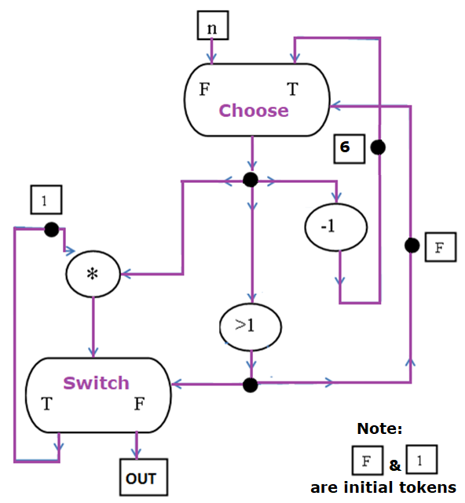
DATA FLOW
GRAPH
EXAMPLE

Slide 15
Data Flow Example
N
0
1
+
<
T F
T F
n

Slide 16
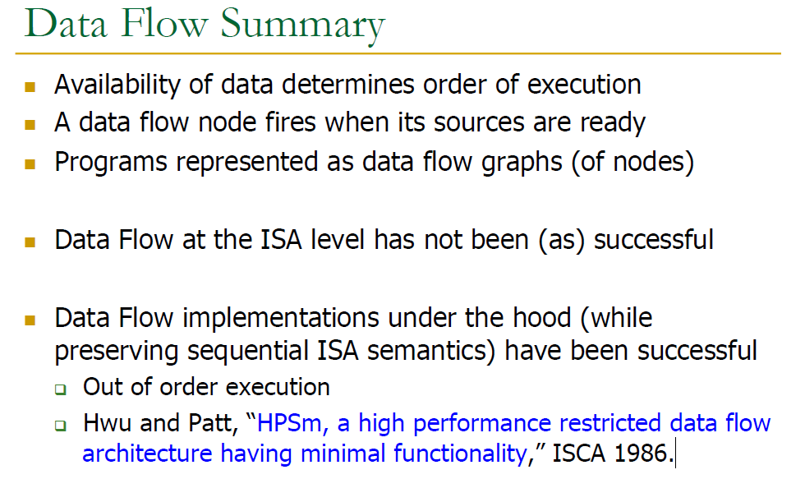

Slide 17
Static Data Flow Machines
Mismatch between the model and the implementation
The model requires unbounded FIFO token queues per arc but the architecture provides storage for one token per arc
The architecture does not ensure FIFO order in the reuse of an operand slot
The static model does not support
Reentrant code
Function calls
Loops
Data Structures

Slide 18
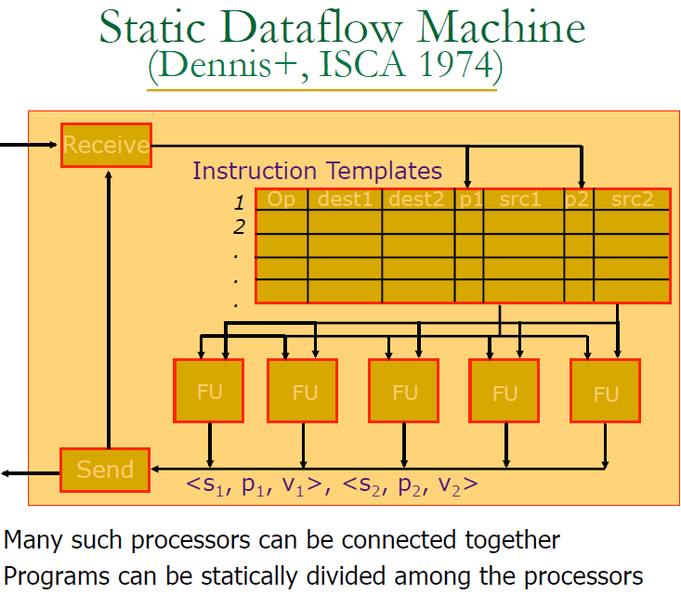

Slide 19
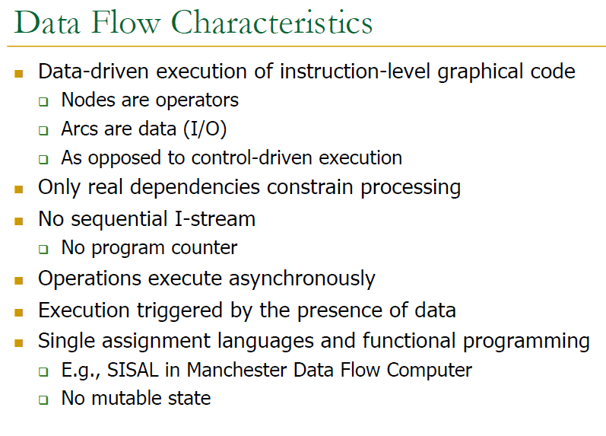

Slide 20
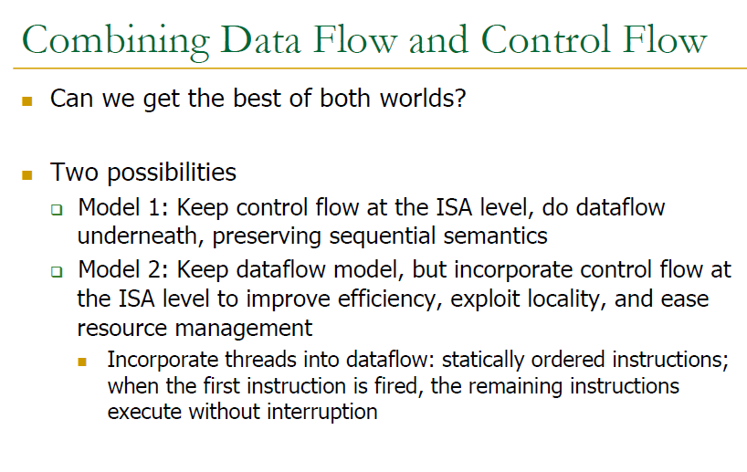

Slide 21
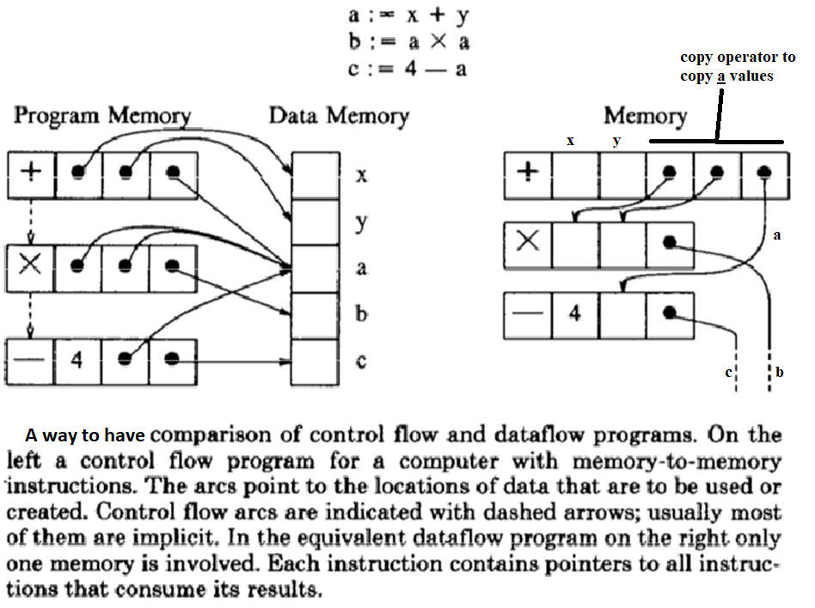

Slide 23
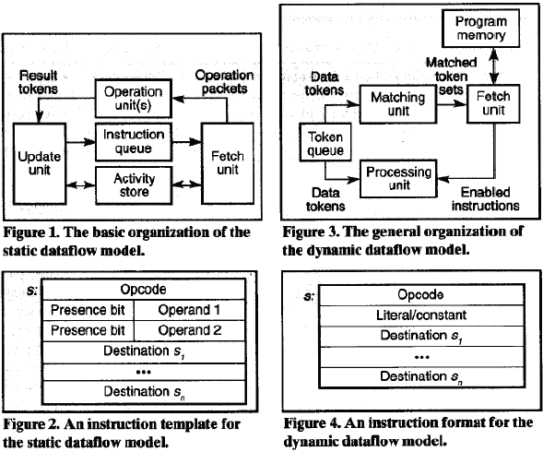
Static vs Dynamic Dataflow Machines

